Slide 1
Video Game Sales Database
Melissa Olhausen, Nathaniel Morris, Solomon Paprocki

Slide 2

Presentation Outline
Description
Functionality
Implementation
Structure
Queries
Demonstration
Evaluation
Conclusion

Slide 3
Description
Application Domain:
This is a database has information about the sales figures of over 16,000 video games
Importance:
This domain is needed to help people learn more about video game sales records

Slide 4
(Functionality) The user can…
View
view top games based on genre and different metrics
Edit
edit game info
Add
add a review to a game
Search
search for a game

Slide 5

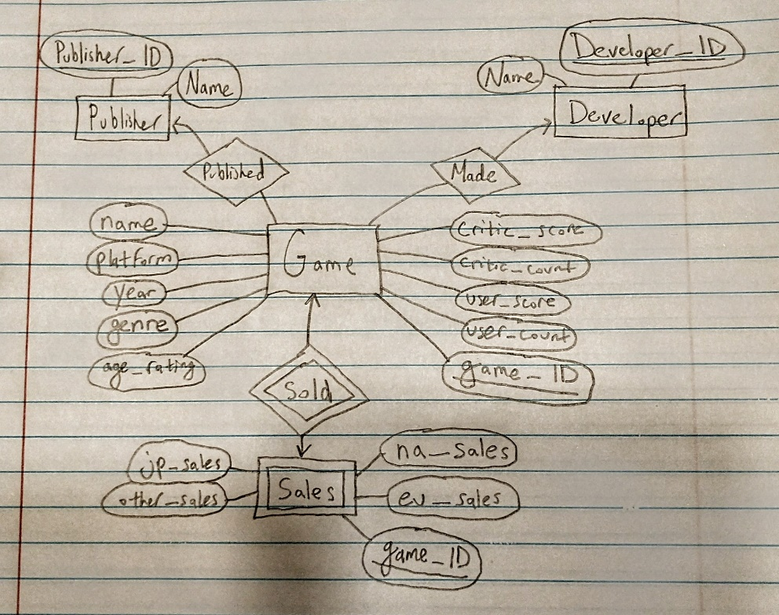
Implementation
There are 4 entities: game, publisher, developer, and sales
Game is connected many-to-one with publisher, where one publisher can have many games. Game has this same relationship with developer.
Sales is a weak entity set, which depends on the ID of game.
There are 4 tables, the game table has over 16,000 records.

Slide 6
Structure
Front-End Scripting: JavaScript, HTML, JSS
HTTP Request
Server-Side Scripting: PHP
SQL
Database Software: MariaDB

Slide 7
Queries
Level 1
Checking if a developer or publisher exists in edit game (2), inserting a new developer or publisher in edit game (2), editing a game (2)
Level 2
Selecting top games by each metric (3), searching for a game/searching for a game to edit (3)
Level 3
Calculating new user and critic scores after a review (2)

Slide 8
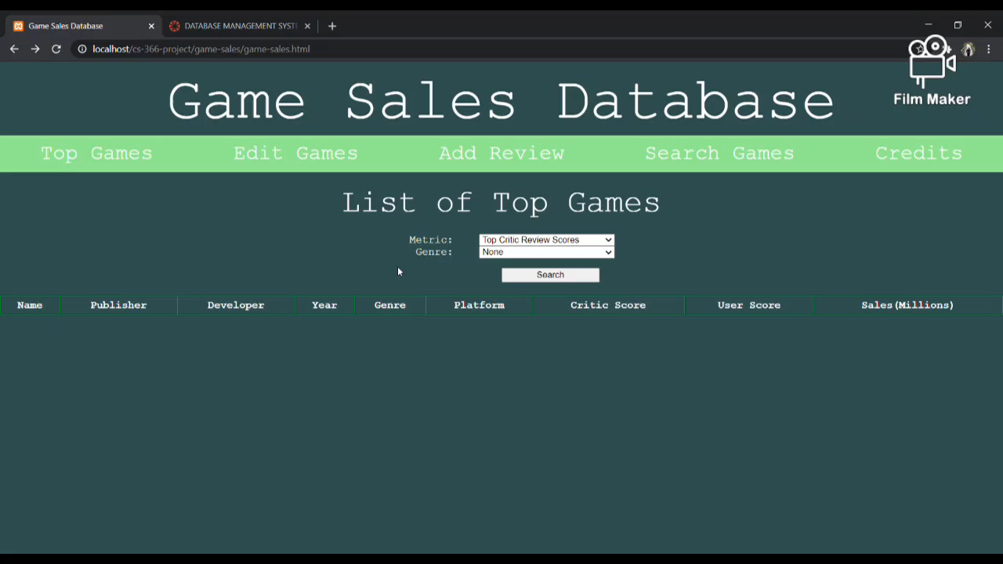
Demonstration

Slide 9

Evaluation
We strived to maintain database integrity
We focused on making our application easy to use
We prioritized keeping things as simple as we could
We did this by making the search work with only the game name field filled in and having dropdowns when possible.
We did this by querying only the information that we needed and by showing only the most important information.
We did this by making sure that all our queries were properly written.

Slide 10

Conclusion
We learned about collaborating as a team
We learned about connecting to databases with our apps
We learned that things can be hard to figure out and plans can change (for example, we spent a lot of hours trying to figure out how to use a Java Servlet, but just ended up using PHP instead)

